Slide 1

CITYCOMPASS
Locating Local Transport in a New City

Slide 2


PROJECT MADE BY :
GEETI (Enrolment No. - E23CSEU1891)
& KASHISH (Enrolment No. - E23CSEU1900)
STUDENT OF 2ND YEAR BTECH CSE AT BENNETT UNIVERISTY

Slide 3
INDEX
PROJECT OVERVIEW
PROBLEM IT SOLVES AND POTENTIAL CLIENTS
GOALS AND OBJECTIVES
PROJECT SETUP
USE CASE AND FLOW CHART
UI MOCKUP
REFERENCES

Slide 4

PROJECT OVERVIEW
CityCompass is a user-friendly website which helps us finding local transport in a city. It gives us information about the transport time, routes, fare, etc. Users can easily plan their routes using CityCompass.
Why we choose this ?
CityCompass is a user-friendly website which helps us finding local transport in a city. It gives us information about the transport time, routes, fare, etc. Users can easily plan their routes using CityCompass.

Slide 5
PROBLEM IT SOLVES AND POTENTIAL CLIENTS
CityCompass solves many problems. Some of them are listed below:
a) Provide more personalised experienced look.
b) It simplifies fare structure, route, maps, and schedules.
c) Useful for people who recently move to a new city.
Target customers of CityCompass includes:
a) Students
b) Tourists
c) New residents
d) Business Travelers
e) People with disability
f) Immigrants

Slide 6
GOALS AND OBJECTIVES
 | Goal or Objective
1. | Develop a platform that integrates at least three transport modes (bike, auto, cab) with real-time data on fares, distances, and times.
2. | Ensure the system is scalable to accommodate future transport options and city expansions.
3. | Provide a user-friendly interface that requires minimal training for new users.
4. | Implement a reliable backend system that updates transport data in real-time to ensure accuracy.
5. | Deliver a high-quality, well-documented system that can be easily supported and maintained.

Slide 7
PROJECT SETUP
 | Decision Description
1. | Frontend will be developed using HTML and CSS for responsive design and accessibility.
2. | Backend will utilize SQL for database management, ensuring efficient data storage and retrieval.
3. | The project will follow coding standards for consistency, including the use of clear variable naming, proper commenting, and modular functions.
4. | User data will be stored securely in compliance with GDPR or relevant data protection standards.

Slide 8
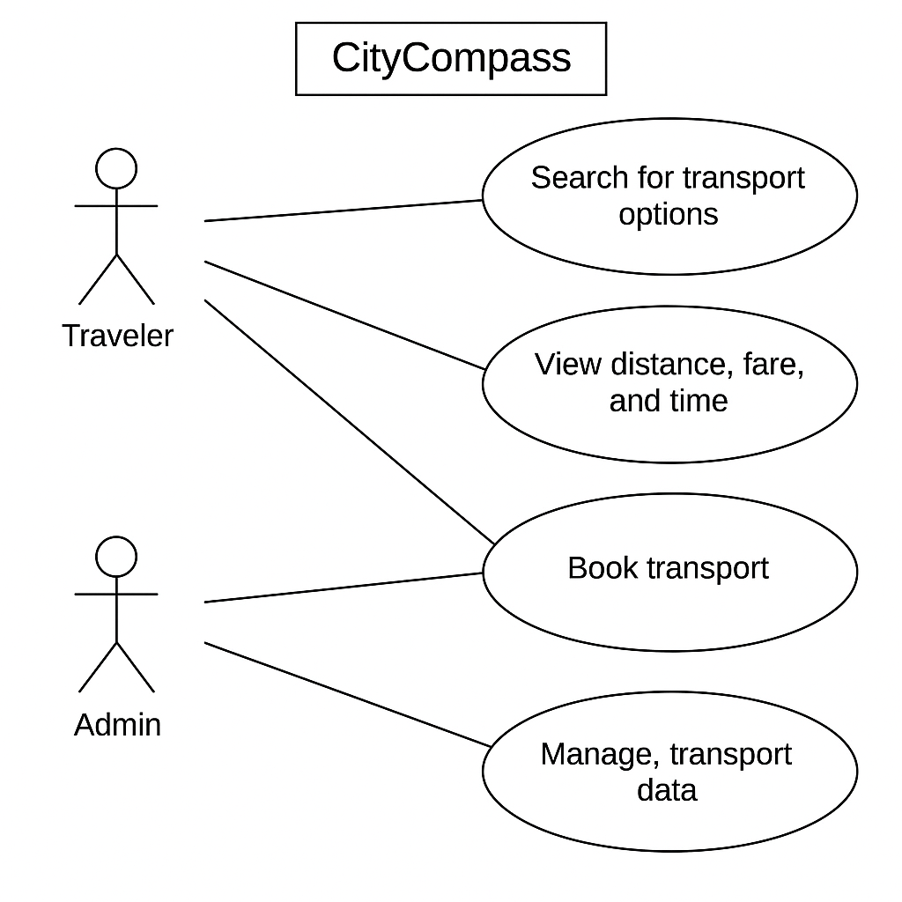
USE CASE DIAGRAM
This the Use Case Diagram for CityCompass. Each use case is uniquely labeleD for easy reference from other parts of the document.

Slide 9
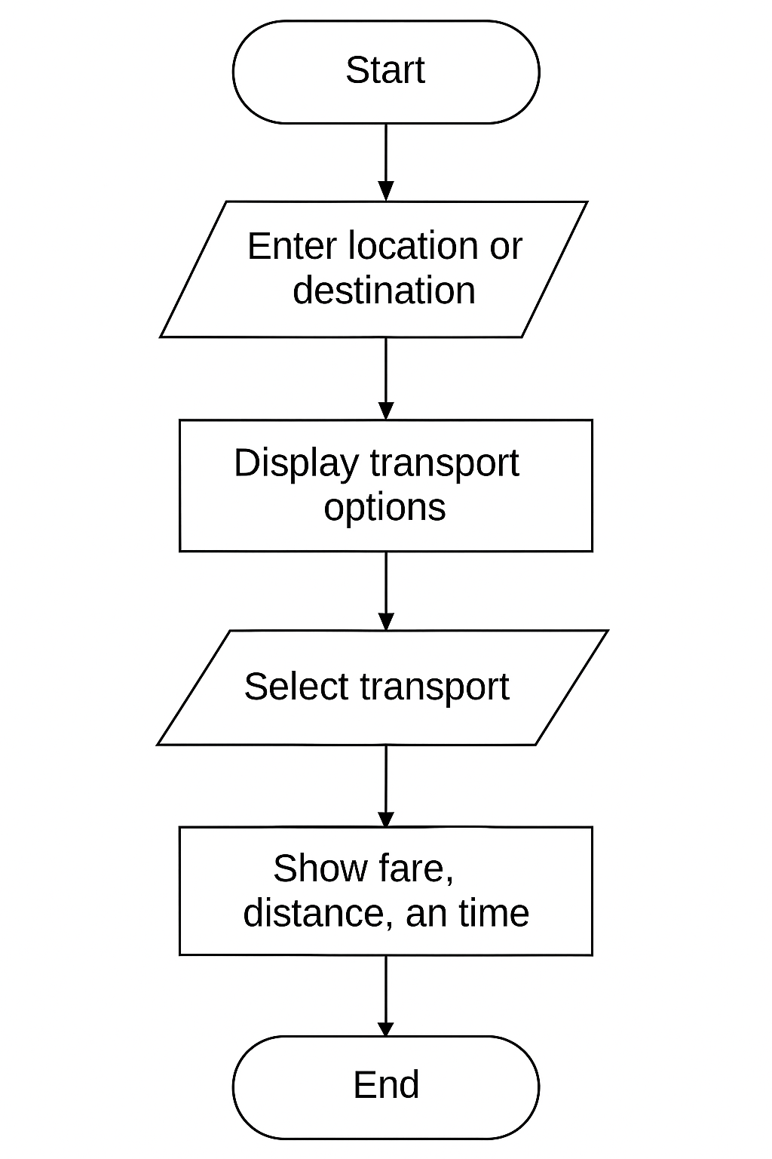
FLOW CHART
This the FLOW CHART for CityCompass. Uniquely labeled for easy reference from other parts of the document.

Slide 10


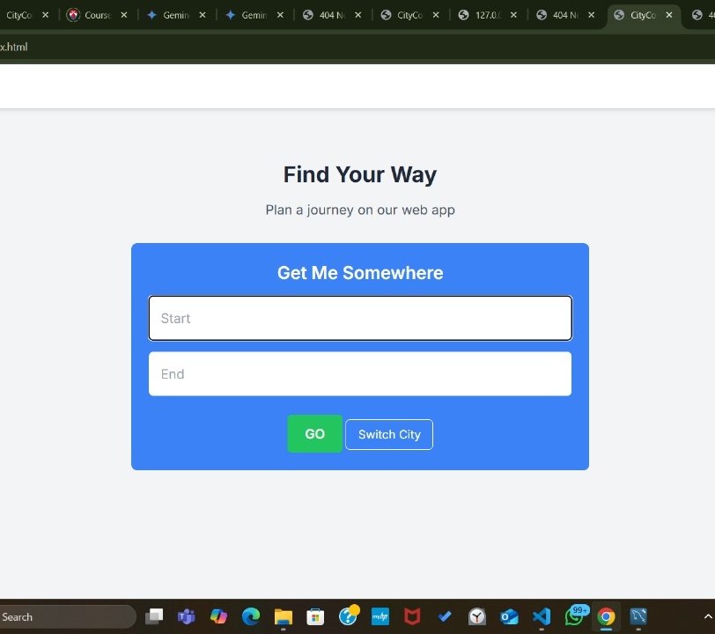


UI MOCKUP
This the USER INTERFACE.

Slide 11
REFERENCES
· Google Maps Platform – Used for location data, geocoding, and mapping services. https://developers.google.com/maps
· Kaggle Datasets – Sourced sample datasets for city transport data and fare estimation. https://www.kaggle.com
· Visual Studio Code – Primary code editor and development environment. https://code.visualstudio.com
· MySQL / SQL – Used for database schema design, queries, and data storage. https://www.mysql.com
· React Native (or Flutter) – For building the cross-platform mobile application interface. https://reactnative.dev / https://flutter.dev
· Stack Overflow – Referenced for resolving development issues and implementation examples. https://stackoverflow.com

